Slide 1
CSYE6225 NETWORK STRUCTURE & CLOUD COMPUTING “Team Ultron”
BANKING APPLICATION
Guided By : Prof. Julian Cooper
By: Pranay Sampat
Ritiksha Gada
Shramika Jadhav
Tanisha Jain
Vega Shetty

Slide 2
Banking Application
Online Banking Application for Customers
AWS Deployment
High Availability
On Demand Scalability
Link: www.ultronbankapp.net/CloudProject-3/

Slide 3
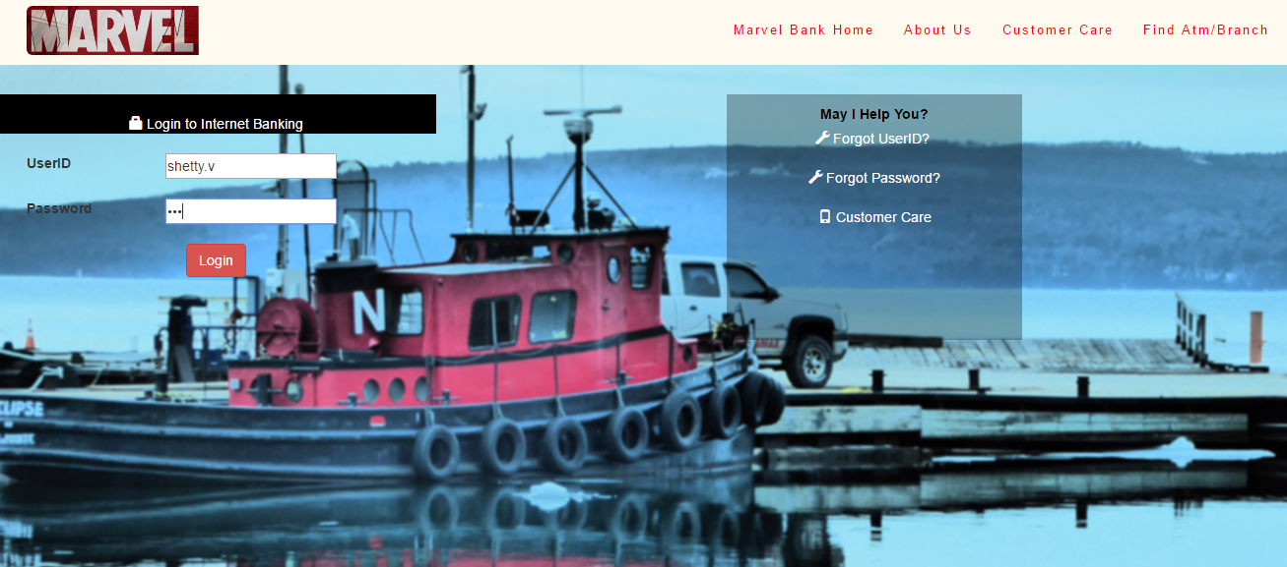
Web Application Home Page

Slide 4
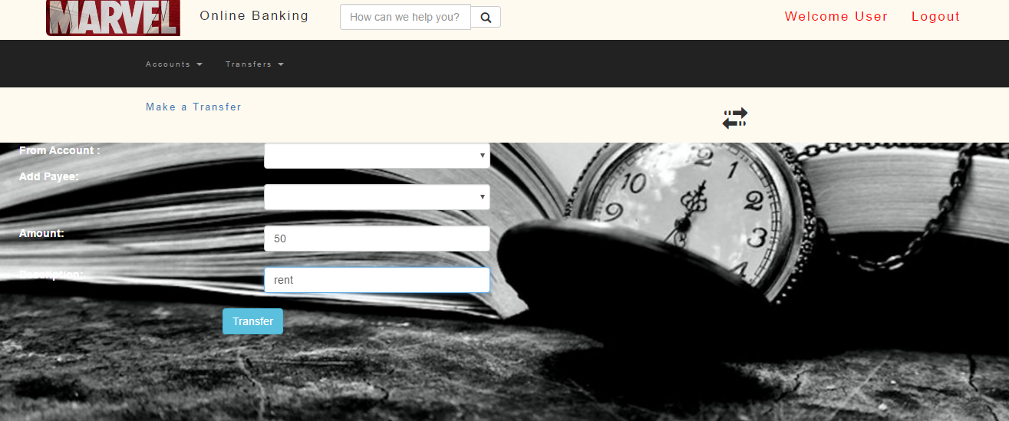
Transactions

Slide 5
Technologies Used
Tomcat
Maven
Spring MVC
Hibernate
RDS
EC2
Travis-Ci
AWS Code Deploy Agent
Route 53
Cloud Watch

Slide 6
Cloud Architecture
Route53
SSL Encryption
Load Balancer for intelligent routing of load
Auto Scaling Groups
AWS RDS with single-AZ deployment
Security Groups, Alarms and Cloud Watch Logs
Disaster Recovery Plan

Slide 7
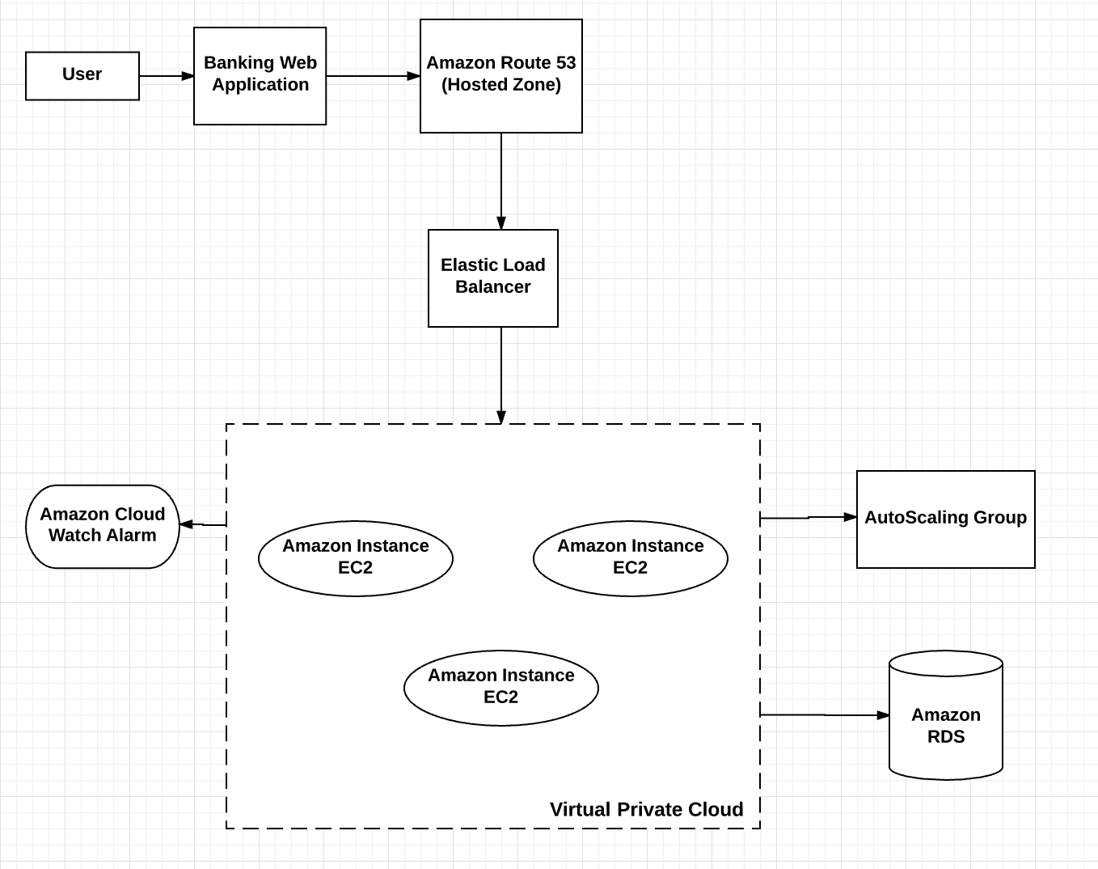
Diagram

Slide 8
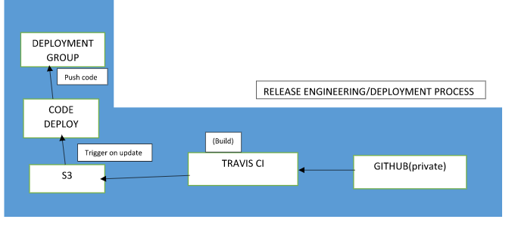
Continuous Deployment

Slide 9
Route 53 & Elastic load balancing
Registered domain name : www.ultronbankapp.net
Hosted zone using Amazon Route 53
AWS certificate manager to provision the SSL certificate.
Classic load balancer with SSL encryption
Benefits:
- Fault tolerance, available , secure and elastic.

Slide 10
Auto-Scaling
Auto scaling is a method used in cloud computing whereby the amount of computational resources are measured in terms of the number of active servers, scales automatically based on the load.
We can control in real time how many instances we want to launch to cover traffic (high and low).
If any of the EC2 instances fails to respond, the ELB will detect it and launch a replacement. When web traffic dies down, instances can be terminated automatically.
Amazon CloudWatch, is a monitoring service for AWS cloud resources. We are using it to collect and track metrics, monitoring CPU utilization, set alarms, and automatically react to changes in your AWS resources.

Slide 11
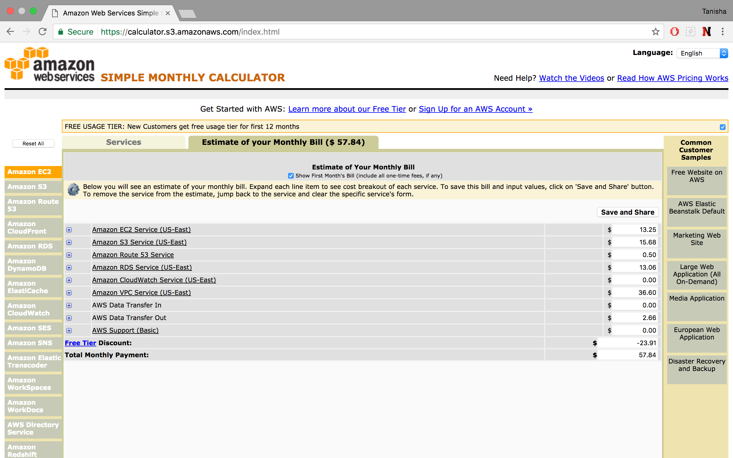
AWS Simple Monthly Calculator - Cost Analysis (3-6 months)

Slide 12
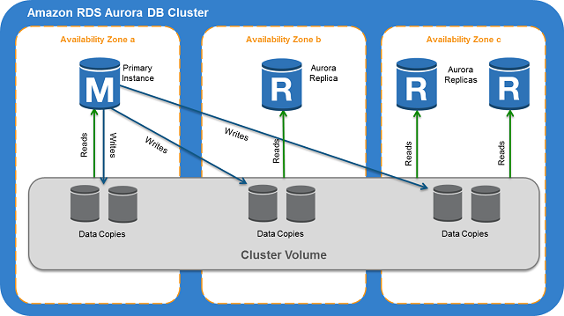
Disaster Recovery
Own Recovery method by RDS
- Automated
- Point in time
Amazon Aurora DB Cluster

Slide 13
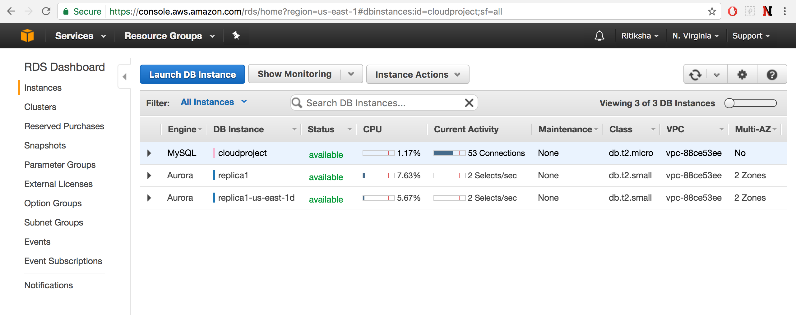

Slide 14
JMETER – LOAD TESTING
JMETER
Testing the number of concurrent users that will be accessing the application
We are testing for 100 users to check login as well as the hits on the website

Slide 15
Challenges
Travis – AWS Code Deploy Agent
Handling Security Issues
Load Testing with many connections at a time.
Routing traffic Automatically from HTTP to HTTPS (Not Implemented)

Slide 16
references
https://aws.amazon.com/documentation/
www.Jmeter.apache.org
www.Docs.travis-ci.com

Slide 17
Thank you
https://www.ultronbankapp.net/CloudProject-3/

